Slide 1
PH-107
Quantum Physics and Applications
Elements of Statistical Physics-III
Gopal Dixit
gdixit@phy.iitb.ac.in

Slide 2



Recap
We are interested in determining the number of particles dN(E) in the system with energy between E and E+dE.
Number of particles per unit volume in the energy range E and E+dE.
Density of states (number of energy states per unit volume) in the energy range E and E+dE.
Probability Distribution function: Dependence on Particle Characteristics
Classical Particles and Quantum (Bosons and Fermions) Particles

Slide 3
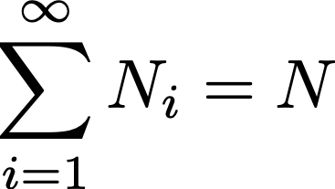
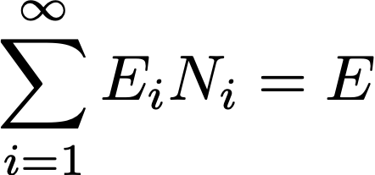
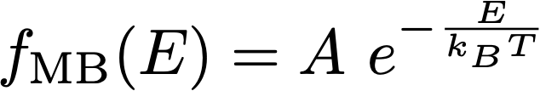
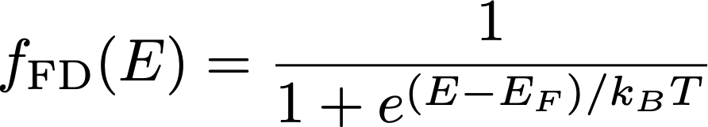
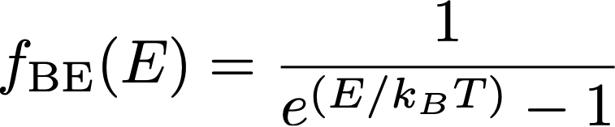
Recap
We need to optimise Q({Ni}) with two constraints
and

Slide 4
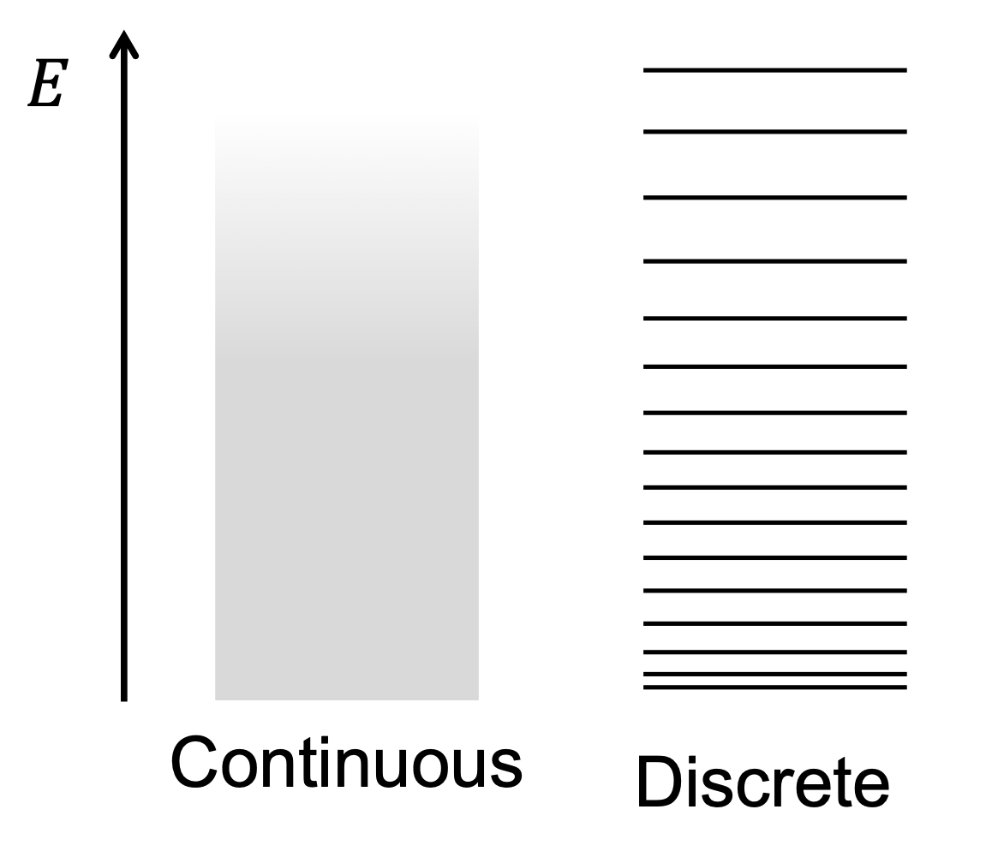
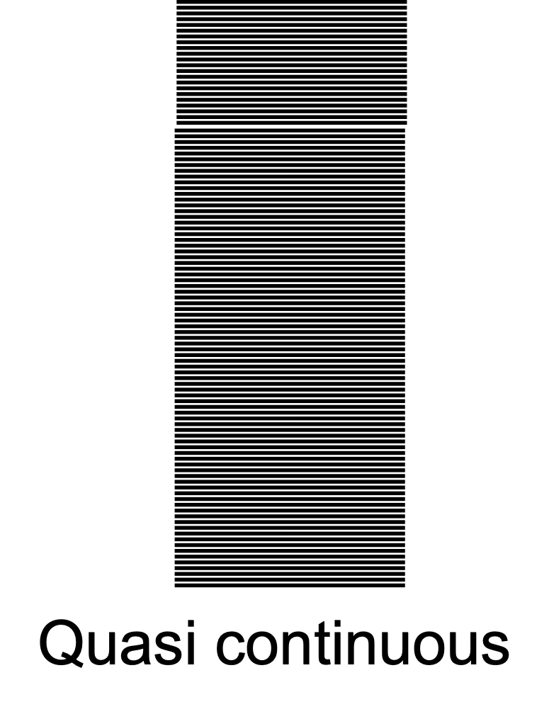
Density of State
Energy Spectrum
g(E)dE: No. of states in the interval dE (about E)

Slide 5
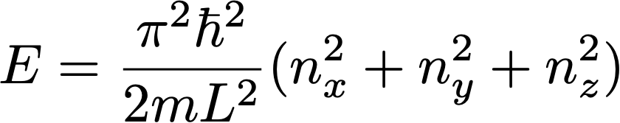
Density of State
Calculation of g(E): Infinite 3D Box
Note that we can label the states as (nx, ny, nz) and arrange them in a (imaginary) 3D space defined by the axes, nx, ny, and nz .

Slide 6
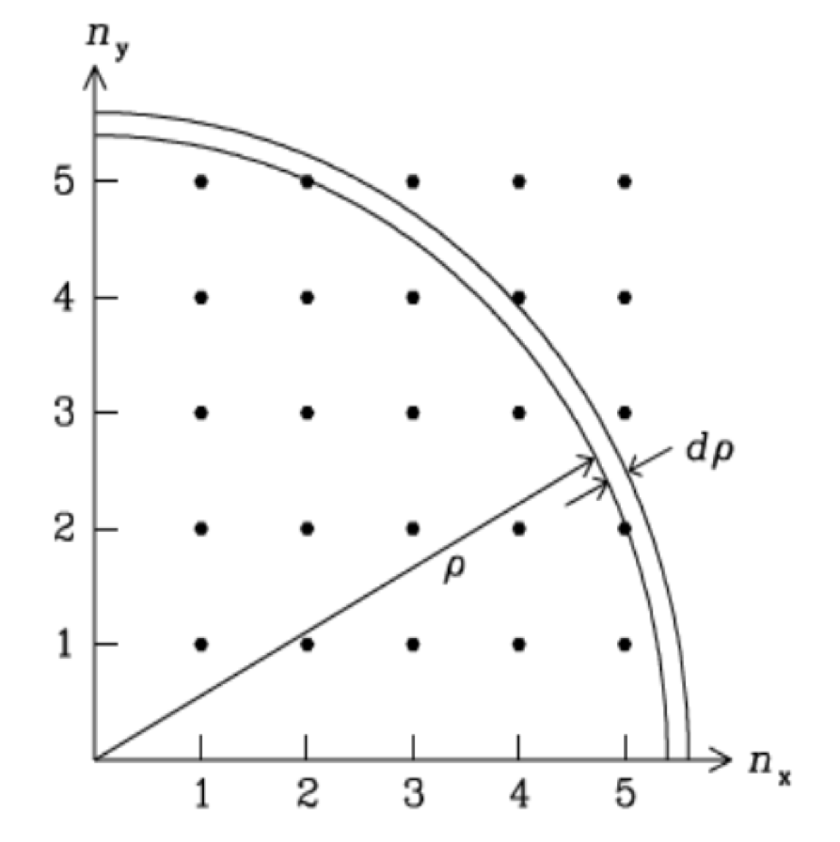
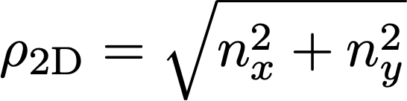
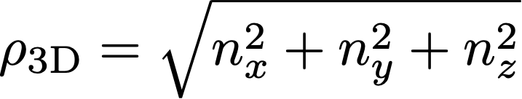
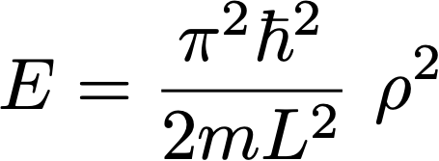
Density of State
Integer Space
This is how we invoke the concept of a integer space (space defined by axes, nx, ny, and nz)
All states which lie within the shell of thickness dρ about ρ are being assigned the energy

Slide 7
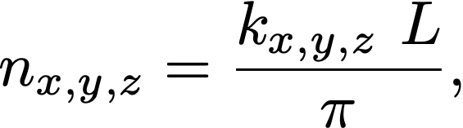
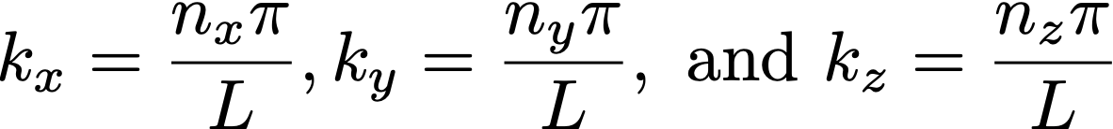
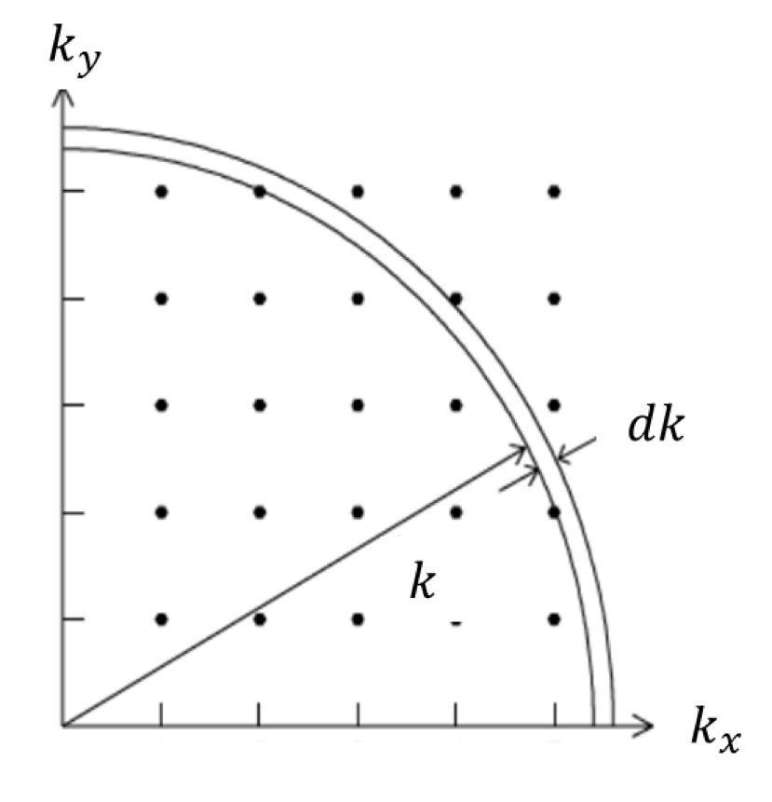
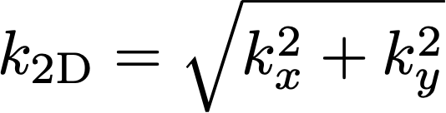
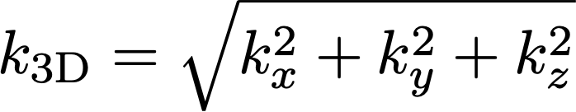
Density of State
Since
we could define an equivalent space
with axes

Slide 8
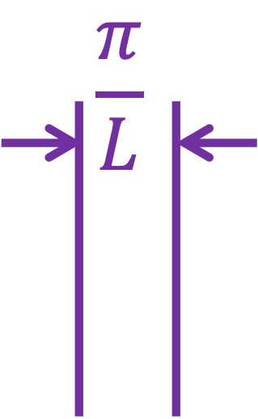
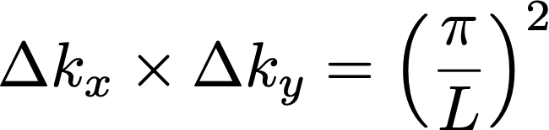
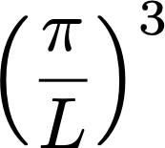
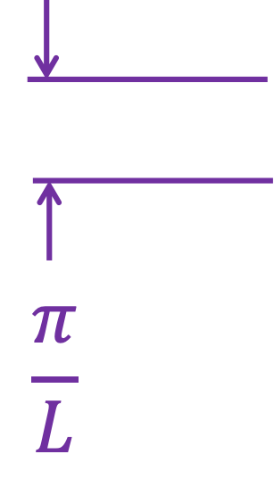
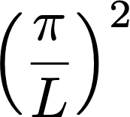
Density of State
What is the area (volume) of the 2D (3D) k-space occupied by each point ?
This area is
In 3D, this volume is
So, the density of points in the
k-space is 1 state per
area
or 1 state per
volume

Slide 9
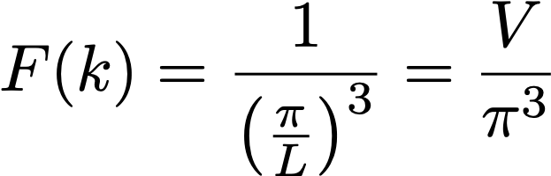
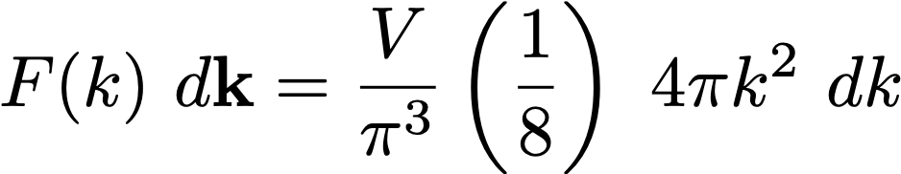

Density of State
We get the density of states in the k space, F(k), as
So, the number of states in the octant of the shell is
Here

Slide 10

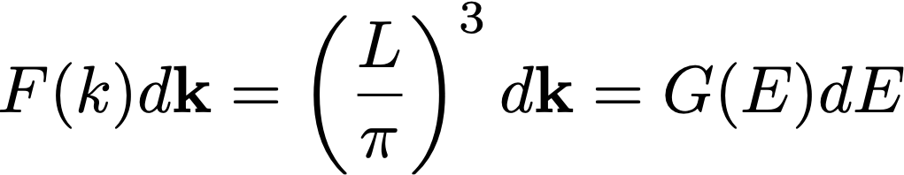
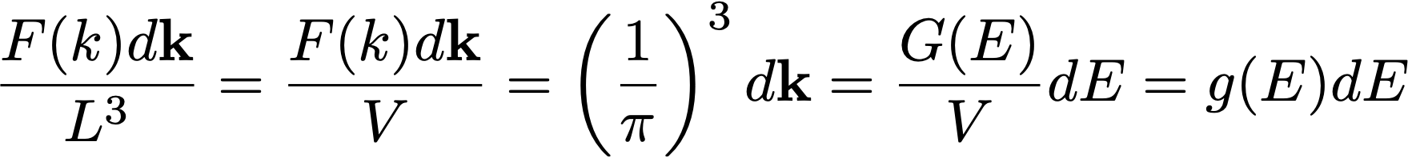
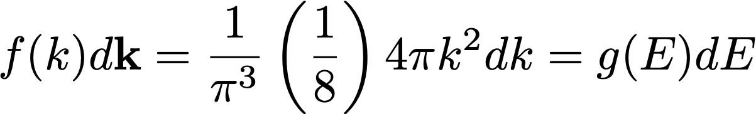
Density of State
Reciprocal Space
But the number of states between k and k+dk should be the same as the number of states between E and E+dE.
So,
i.e.,
This implies
i.e.,

Slide 11
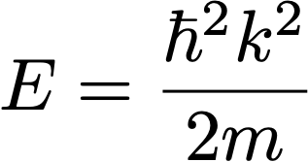
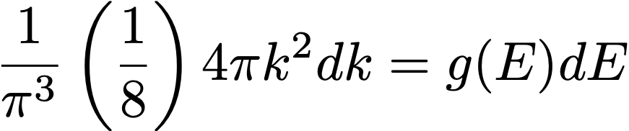
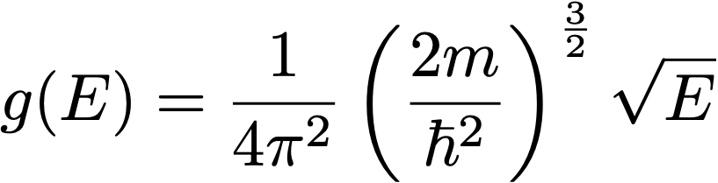
Density of State
Reciprocal Space
Now, let us recall
And make use of it in
to get the expression for the density of states in terms of energy as

Slide 12
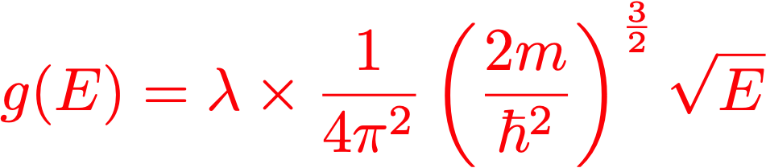
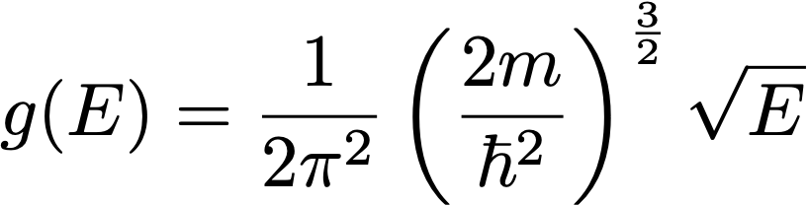
Density of State
Reciprocal Space
If there are other degeneracies of each k-state (for example the spin-degeneracy of Fermions), we need to multiply g(E) with the degeneracy factor, (let’s say) λ.
So,
So, in case of electrons (Fermions) bound to the 3D potential well, we have

Slide 13
Application of M-B Distribution

Slide 14
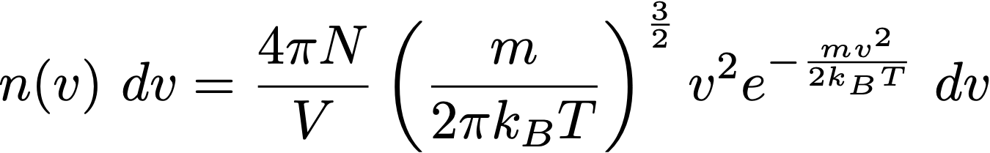


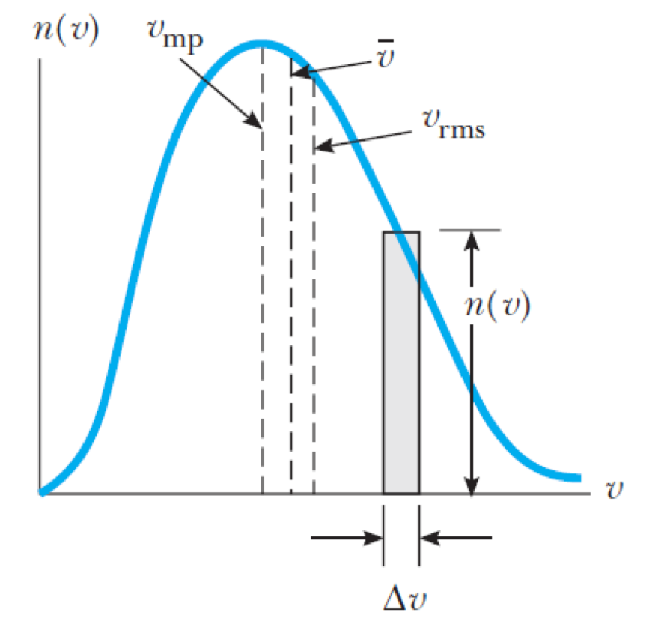
Maxwell-Boltzmann Distribution
Maxwell speed distribution function for gas molecules at thermal equilibrium at temperature T
Here,
is the number of (ideal) gas molecules (of mass m)
per unit volume with speed between

Slide 15
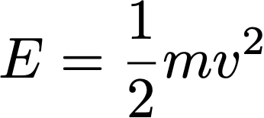

M-B Distribution
We know
In the present case:
Also, we know
So, every v corresponds to unique E
and therefore,
Density of states in the energy interval E and E+dE
Density of states in the velocity interval v and v+dv
So, let us estimate number of states with velocity between v and v+dv

Slide 16
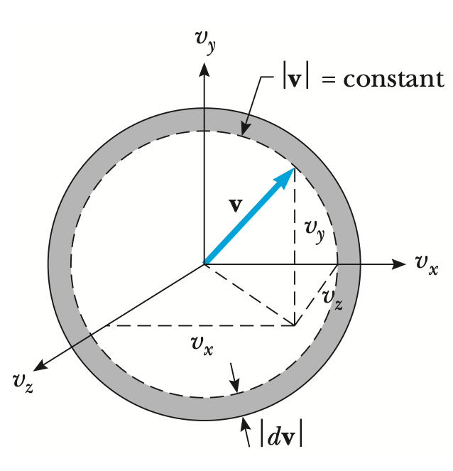



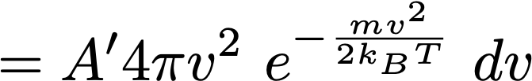

M-B Distribution
Volume of the spherical
shell between v and v+dv
constant
Total number of particles per unit volume =

Slide 17
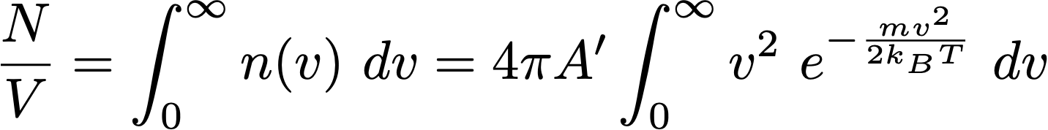
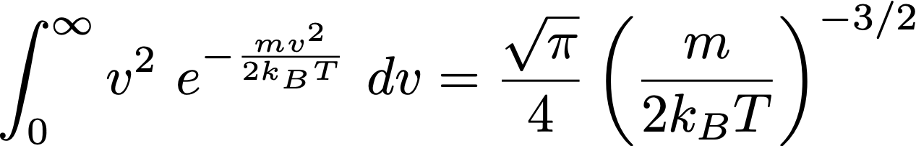
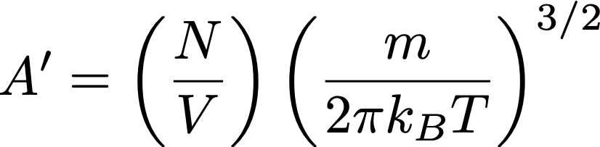
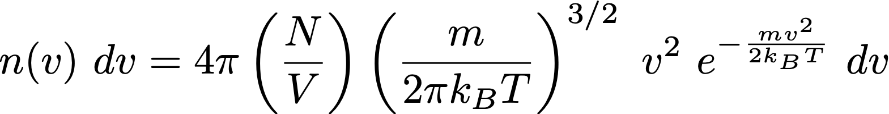
M-B Distribution
Total number of particles per unit volume =
Maxwell Boltzmann speed distribution for gas molecules in thermal equilibrium at temperature T.

Slide 18
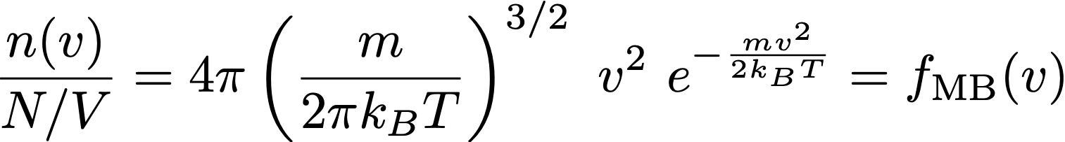
M-B Distribution
No. of gas molecules per unit volume having velocity in v and v+dv
Total number of molecules per unit volume
Maxwell-Boltzmann speed distribution
Fraction of molecules having velocity in v and v+dv

Slide 19
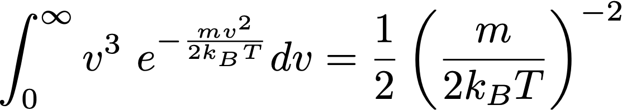
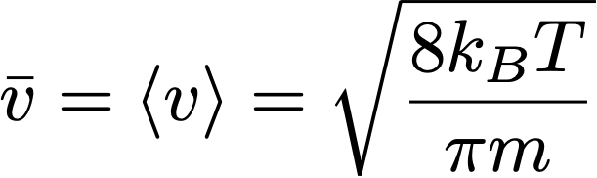
M-B Distribution
Average speed

Slide 20
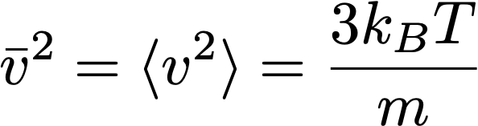
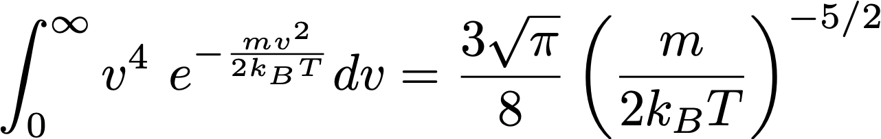
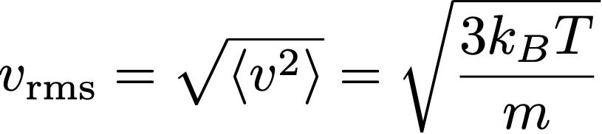
M-B Distribution
Mean square speed
Root mean square speed

Slide 21
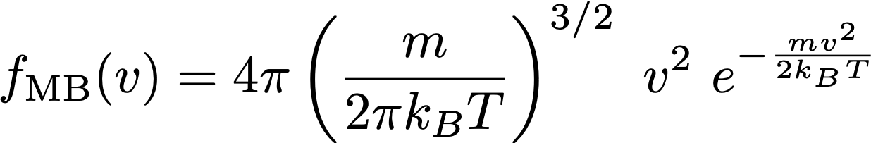
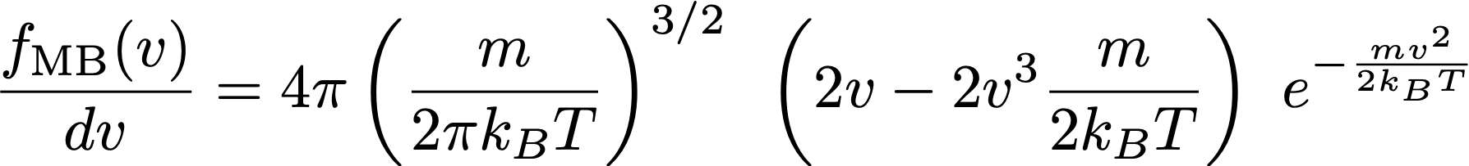

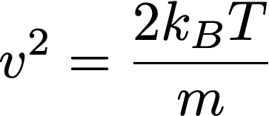

M-B Distribution
Most probable speed
We know
Let us differentiate this wrt v

Slide 22


From Kinetic Theory of Gases

Slide 23



M-B Distribution
Average Kinetic Energy
Kinetic Energy =
Average Kinetic Energy =
Mean square speed
This is the statement of equipartition theorem
A classical molecule in thermal equilibrium at temperature T has an average energy of kBT/2 for each degree of freedom.

Slide 24

Show that standard deviation of the molecular speeds is given by

Slide 25

Recommended Readings
Statistical Physics, Chapter 10

